Slide 1
Hooks & Extensions Assignment
January 1, 2026

Slide 2
Workflow Description
AI as a Student : Step-by-step
Given below are the steps of my study-system workflow.
1. My project has an agent named study-notes that generates study content on a given topic or concept title.
2. My project also has tutor-agent that uses specialized and focused expertise of study-notes to support step by step learning on a given topic, or concept.
3. The flashcard-agent in my project uses output from step 2 together with specialized and focused expertise of study-notes agent and its own ability to generate flashcards that help user in interview and exam preparation and concept reinforcement.
4. My quiz-master intelligently wraps specialized and focused expertise of study-notes and contains expertise to generate meaningful questions from source content, to generate assessment items from learning material, to design evaluative questions to measure understanding, to promote active recall from learned material
I want to create a hook that automates the study-system workflow. What event should trigger it? What command should run? What should I watch out for?

Slide 3
Workflow Description
Recommended Architectural Approaches
Given below are the proposed three superior alternatives to hook-based automation for study-system workflow.
Option 1: Slash Command Orchestration (Recommended)
Option 2: Dedicated Study-Coach Agent
Option 3: Hybrid Approach with Hook-Based Validation
Option 3 - Architecture:
1. Primary orchestration: Use slash command or study-coach agent (as above)
2. Hooks for enforcement: Add hooks to ensure workflow integrity

Slide 4
Workflow Description
Recommended Architectural Approaches
1. What event should trigger the hook?
For initiating the workflow:
- UserPromptSubmit: Intercept user prompts and detect workflow trigger keywords
- Match patterns like "start study session on [topic]"
- Inject additional context to guide the main agent toward orchestrating the workflow
- Limitation: Cannot directly invoke agents; can only influence the main agent's behavior
For chaining agents sequentially:
- SubagentStop: React when each agent completes
- Evaluate completion status
- Decide whether to continue to the next agent
- Limitation: Requires complex state management in the hook script to track workflow position

Slide 5
Workflow Description
Recommended Architectural Approaches
2. What command should run?
Given the complexity of sequential agent invocation, the hook command would need to:
#!/usr/bin/env bash
# .claude/hooks/study-workflow-orchestrator.sh

Slide 6
Workflow Description
3. What should you watch out for? - Critical Considerations:
1. Architectural Mismatch: Hooks are meta-level governance mechanisms, not orchestration engines
- Attempting to orchestrate complex workflows via hooks violates their design intent
- You are essentially implementing a state machine in a reactive callback system
2. Context Propagation Challenges:
- Hooks receive limited context via stdin
- Accessing prior agent outputs requires reading session transcript files
- Transcript parsing adds complexity and fragility
3. Infinite Loop Risk:
- SubagentStop hooks that block without checking stop_hook_active can cause infinite loops
- Always implement loop-breaking logic: if stop_hook_active then allow

Slide 7
Workflow Description
3. What should you watch out for? - Critical Considerations:
4. State Synchronization:
- Workflow state files can become corrupted if hooks fail mid-execution
- No transactional guarantees for state updates
- Multiple concurrent workflows (unlikely but possible) would corrupt shared state
5. Debugging Opacity:
- Hook execution is hidden unless verbose mode is enabled (Ctrl+O)
- Failed hooks fail silently if exit codes are not properly configured
- Error messages in stderr are not always visible to users
6. Timeout Exhaustion:
- Complex orchestration logic may exceed default 60-second timeout
- Silent failure if timeout is exceeded
- No automatic retry mechanism
7. Maintenance Burden:
- Hook scripts require separate testing and validation
- JSON output schema must be meticulously correct
- Changes to agent APIs require corresponding hook updates

Slide 8
Workflow Description
Creating settings.json
Create a project level settings.json (project preference) file to generate notes for me. I’m a medical student with no engineering background. My domain expertise are in biology so always relate your examples with nature and living things for my improved understanding. Use context7 to create setting.json file in claude code following proper standards.
Creating comprehensive configuration that automatically injects my medical background context into every session, ensuring all technical explanations employ biological analogies.
.claude\hooks\inject-medical-context.py
Write(.claude\settings.json)

Slide 9
Workflow Description
Creating settings.json
Hook Execution Lifecycle
Session Start → settings.json loaded → SessionStart hooks detected
↓
Python script executed → JSON received via stdin
↓
Context constructed → JSON output to stdout (exit code 0)
↓
Claude Code absorbs additionalContext → Context persists throughout session
↓
All subsequent responses employ biological analogies

Slide 10
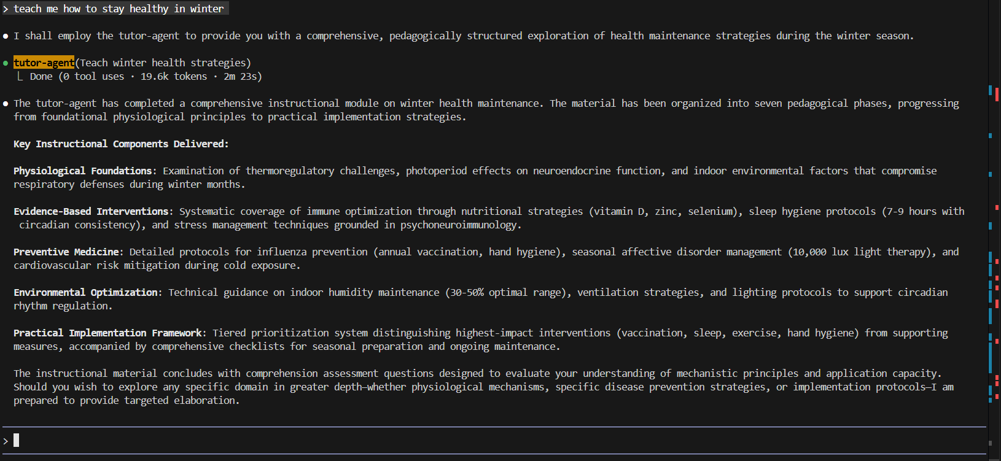
Agent Activation

Slide 11
Agent Description
Flashcard-Agent
Create an agent named flashcard-agent that tactically uses specialized and focused expertise of study-notes, tutor-agent and its own ability to actively recall (strengthen long term memory and reveal knowledge gaps), spaced repetition (prevent forgetting, optimize study time, increased retention with low effort), concept reinforcement, perform self-assessment and feedback, help in interview and exam preparation, skill automation (debugging heuristics, design patterns, medical protocols, legal tests, command syntax) and to guide user in learning new language (through increased vocabulary, grammar patterns, sentence structures and pronunciation cues).
Use this agent when the user has learned a topic or concept to reinforce memory, during review, exam prep, spaced repetition or for support in learning a new language.
Activation Prompt: Using the Tutor Agent Output above, generate a flashcard that tests understanding, not memorization. Focus on conceptual distinction and application scenarios

Slide 12
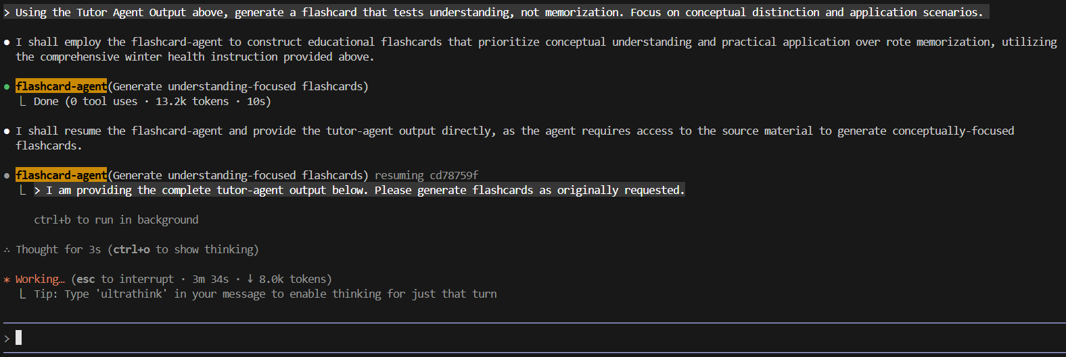
Work in Progress

Slide 13
Agent Description
Quiz-Master
Create an agent named quiz-master that intelligently wraps specialized and focused expertise of study-notes, tutor-agent and contains expertise to generate meaningful questions from source content, to generate assessment items (questions, prompts, distractors) from learning material, to design evaluative questions to measure understanding, to promote active recall from learned material, to reinforce learning during study, to encourage explanation and reasoning, to verify comprehension of key concepts and to guide user learning through multi-step pedagogical approach.
Use this agent when the user wants to reinforce newly learned concepts, evaluate their understanding of a topic, or practice active recall during or after study.
Activation Prompt: Using the Tutor Agent Output above, generate a 2 question quiz

Slide 14
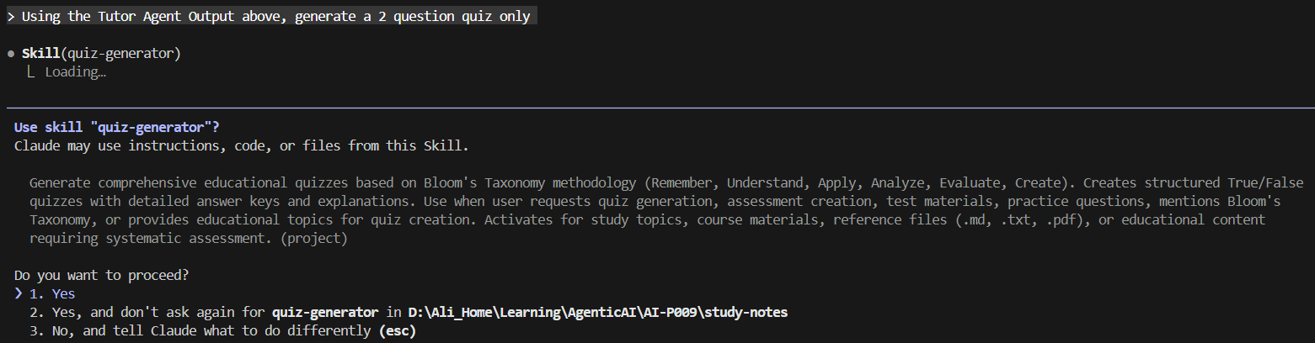
Work in Progress

Slide 15
Agent Description
study-coach
Create an agent named “study-coach” that coordinates the other three agents (tutor-agent, flashcard-agent, quiz-master) to ensure the tutor-agent manages to teach the user, flashcard-agent manages to reinforce memory (during review, exam prep or spaced repetition) and quiz-master intelligently reinforces learning (newly learned concepts, evaluate understanding, practice active recall).
Use this agent when the user has completed the learning from tutor-agent, memory reinforcement from flashcard-agent and reinforced learning from quiz-master.
Activation Prompt: Use the study-coach agent to manage the agent coordination of very briefly teaching a 30 years old health enthusiast how to stay healthy in winter. Then firstly use the output to create nothing else but a short flashcard. Then, also use the same output to generate a two question quiz only.

Slide 16
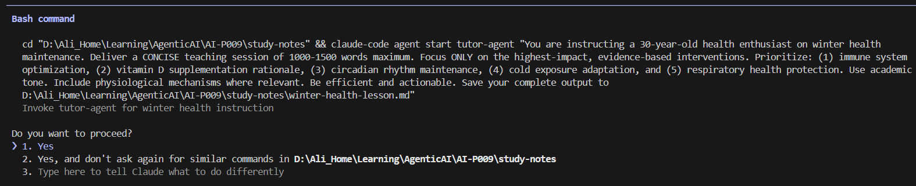
Work in Progress: winter-health-lesson.md

Slide 17
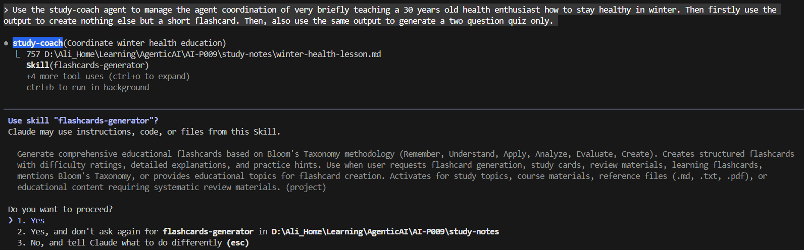
Work in Progress

